Slide 1
AT&T Global Business Strategy Network Users Forum 2011
Fabiano Del Soldato
Director of Sales – Latin America
AT&T Business Solutions
fsoldato@att.com

Slide 2
The cloud is everywhere these days…

Slide 3
Disruptive Macro Trends
Globalization
Virtualization
Collaboration
Mobile Society
More Distributed Enterprise
Markets & Resources
More Unpredictable Environment
Value Chain & Endpoints
More Productivity
Virtual teams & integrated value Chain
More Interactive Users
Ubiquity & Information access
Page 3
© 2010 AT&T Intellectual Property. All rights reserved. AT&T and the AT&T logo are trademarks of AT&T Intellectual Property.
3
Notes:
3
Globalization: companies are increasingly moving onto (or retrenching from) new geographies/countries. This means: (McDonalds 60%, Coca Cola 70%, Intel 80%)
Decisions on how to extend your networks and apps.
How to support users 24 x 7 365
Understanding the regulatory, legal and operational issues (Costa Rica IPT example)
Virtualization:
Decisions on how my to do in house versus relying on partners. One survey finds:
- About 8 in 10 companies outsource at least one IT activity.
- 50% of corporations outsource their logistics and warehousing functions.
- Close to 40% have outsourced their entire supply chains.
At the same time your employees are moving into distributed environments, technology is enabling more centralization (huge DCs, blade servers, single global instances of apps).
Advanced global IP networking capabilities deliver on this requirement by enabling and creating a single virtual company … regardless of where the computing power or work is being performed.
Mobile Society: how to manage the mobile needs from a device, plan, policy and security perspective
Leads to INCREASED COMPLEXITY

Slide 4
Facing Clear Technology Shifts and Challenges
56% of Enterprises supporting BYOD
5,000% wireless data increase over last three calendar years (AT&T)
Application downloads will exceed 25 billion in 2011
Forrester: Enterprise & SMB Network And Telco Survey, 2010
Gartner Dataquest Insight App Stores Feb. 2010
Enterprise smartphone penetration increased 59% to 73% (‘09-’10)
Backbone traffic doubling every three years (AT&T)
45% cite managing or implementing mobile enterprise apps as top 2011 priority
TNS Business Wave Program 2010
Sybase survey 1/12/11
Average smartphone usage up 40% (YOY)
43% rate smartphone security as “high” concern
29% of IT operating and capital budgets spent on app development & support
Forrester Mgd Mobile Computing Complexity 2010
Forrester 2010 IT Budget Allocations
1 Trillion connected devices to the Internet by 2013
70% of technology spend depreciating on books
9% of 2012 worldwide IT spend estimated to be on cloud services
Cisco CTO 2010
IDC
Notes:
The penetration and growth in new technology has been incredible over the past few years.
The penetration of smartphones in enterprises increased 14% last year.
One of the biggest trends is in Bring Your Own Devices. Device choice is very personal. Customers chose a device because of form factor and user interface preferences that they have. We can no longer dictate which device to use.
More smarter devices are driving network growth. Mobile data usage has increase by 5,000% over the past three years. Our backbone now carries over 21 Petabytes (15 zeros) per day of traffic.
In 2011, 25 Billion applications will be download in 2011. The number of business centric applications downloaded is going to accelerate as private and public enterprise store fronts are developed and deployed.
However, for all of the discussion about cloud, the estimate that in 2012 cloud with comprise 9% of total Worldwide IT spend.

Slide 5
A Consistent and Systematic Global Strategy
Investment of $1Billion in 2010. Builds on a total target investment of $4 Billion for global capabilities since ‘06.
“AT&T combines wide geographic coverage, a broad portfolio and good service quality to achieve a strong position in the global network services market” Gartner March ’10
AT&T positioned in the Leaders Quadrant in the latest report for global network service providers. Gartner March ‘10
Magic Quadrant for Global Network Service Providers by Neil Rickard, Robert F. Mason (01/23/09) is copyrighted by Gartner, Inc. and is reused with permission. The Magic Quadrant is a graphical representation of a marketplace at and for a specific time period. It depicts Gartner’s analysis of how certain vendors measure against criteria for that marketplace, as defined by Gartner. Gartner does not endorse any vendor, product or service depicted in the Magic Quadrant, and does not advise technology users to select only those vendors placed in the “Leaders” quadrant. The Magic Quadrant is intended solely as a research tool, and is not meant to be a specific guide to action. Gartner disclaims all warranties, express or implied, with respect to this research, including any warranties of merchantability or fitness for a particular purpose. This Magic Quadrant graphic was published by Gartner, Inc. as part of a larger research note and should be evaluated in the context of the entire report. The Gartner report is available upon request from AT&T.
Notes:
5
Source Approved by Legal as part of Global Investment Materials March 2009
Feb 23, 2009 — AT&T announced plans to invest approximately $1 billion in 2009 to continue building out its global network, while driving new services and network-based applications to businesses ranging from the largest multi-national corporations around the world to the smallest companies served within the United States.
AT&T’s investment is focused on the network infrastructure, services and support for companies requiring “anytime, anywhere” access to the systems, suppliers, customers and employees needed to successfully run their businesses. Spurred by continued demand for business applications made possible by the proliferation of high speed communication networks and mobile devices worldwide.

Slide 6
AT&T Business Solutions Strategy Deliver an intelligent, secure global networking platform for on-demand application performance
The Network Delivering consistent services across fixed and mobile devices
Intelligence Optimizing availability, utilization and performance
Application Infrastructure
Creating a platform for applications — reducing complexity and costs
Applications
Deploying apps efficiently — anywhere, anytime,
to any device
Notes:
KEY MESSAGE AND VALUE TO CUSTOMERS: With your business challenges in mind, we’re embarking on a multi-year journey to deliver solutions and expertise that enable you to work more effectively within your enterprise and with all participants in your value chain. In other words – to improve your performance and deliver results back to your business. We’ll discuss our strategy in greater detail, but here’s the approach:
click
At the center of our strategy – the global network.
We have always been – and will continue to be – a networking company. After all, it’s the “network” that connects people and resources so things get done. Enabling your associates and partners to connect – anywhere, anytime – improves speed, precision and output…it’s what creates advantage for your business.
We’ve got four priorities with the core network:
1. Delivering unmatched scale, reach and reliability (Access to 155 Countries, OC768, 3G, 13.5 Petabytes a day)
2. Providing a converged, global platform with a common protocol – voice/data, wired/wireless, local/global available in multiple access options, WiFi, Ethernet, IP
3. Offering globally consistent access to capacity and features– available to users wherever they are, whenever they need it
4. Allowing you to connect via wired or wireless access with the same predictable performance As we manage the network, we gather information about congestion, routing and capacity – information that can make applications smarter.
click
We’ve embedded proprietary intelligence into our network/services that will optimize availability and performance to improve your application throughput. What do we mean by intelligence?
Through both science and discipline we use data and analytics from call handling, routing, congestion and performance to detect and manage proactively for optimized availability. We couple with specific routing capabilities that we’ve layered on top of basic IP routing to provide quality of service and improved performance for you.
The tool sets that we provide including reporting and management portal, app acceleration and security policy management capabilities use these analytics to provide visibility into the increased performance and throughput your applications require
(Time of day, originating destination, IRSCP (Intelligent router services control point) which uses utilization and congestion data to determine most efficient route, IMS which supports call handling based on session knowledge and locality to enable seamless call and feature handling across wireline/wireless endpoints)
click
We’ll then expand the reach of the network by “attaching” computing processing and storage infrastructure to support applications. Basically, this allows us to “virtualize” capacity to offer you better performance and greater economies of scale.
We have 38 global Internet Data Centers - and plan to expand capacity by another 260,000 square feet by the end of 2010 – bringing our total to about 900,000 square feet by year end. We’re also investing in a nearly 6-fold increase in caching and live streaming capacity
It’s basically a shared services model that allows you to minimize capital expenditures and protect your investment – yet gives you access to the scale and speed of the whole network. We’ve “attached” collaboration and messaging exchange engines as a part of this application infrastructure to improve performance of these communication applications. We bare investment and scale where you need to be…. Examples: Hosting, Content Distribution and Security
click
Ultimately, we’ll use this infrastructure to deliver applications that we provide or that you bring which will give you access to business information on your choice of endpoint, anywhere around the globe…enabling you to work more effectively across employees and partners
A variety of industry applications like Oracle, SAP, and Ariba – available on a shared or dedicated basis and are industry certified.
Applications that AT&T will develop – Unified Communications, Video portion of CDN, call processing
Others you can develop yourself and request that we manage for enhanced performance.
And finally, we apply a wealth of technology and business process expertise – both organically created and gained from the IBM partnership – to develop complex solutions that leverage our scale, allowing customers to off load non-core activities to us.
Over 13,000 network integration professionals worldwide that provide services that include: Network Integration & Professional Services, Managed Network and Hosting Services, Complex Strategic Sourcing, 19 Global Client Service Centers where we today manage Over 255,000 client routers, Over 122,000 client hubs and switches, Over 13,500 security devices, Over 15,000 servers, Over 6,200,000 voice ports

Slide 7
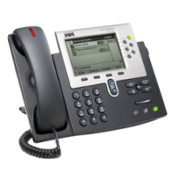
We’re Reinventing Networking To enable customers to rethink their businesses
AT&T Delivers the Power to Connect & Collaborate
Virtually anywhere, anytime applications
Connecting through your device of choice
Real-time, media rich interactions
With deep expertise and credible leadership
And a Highly Secure End-to-End Ecosystem
Notes:
Network is at the Core of Business..
The AT&T Vision is to connect people to their world everywhere they live and work and do it better than anyone else. A forward-looking technical architecture will enable us to achieve this vision. To enable clients to receive maximum benefit from convergence, AT&T is driving to have one highly secure, core network transporting all of our services, including video.
We are deploying IMS (IP Multimedia Subsystem) technology to enable consolidation of our wireless and wireline networks.
An IMS-based architecture will provide tremendous value to our customers through enabling lower cost solutions and quicker feature introduction built on a platform designed for new and evolving IP services. With its acceptance by the telecommunications industry and with work currently in progress to enhance and improve it, we are confident that IMS will become the standard architecture supporting the multi-access and multi-application networks of the future. Having such a standard architecture is a critical step in the evolution that is needed to transform the networks of the 20th century into those needed in the 21st century.
This architecture enables the elimination of traditional distinctions such as “mobility service” or “international service.” There will simply be services, and users will be able to access them wherever they are, via any access network or any device.
Network
The AT&T network includes extensive wireless and wired access capabilities, as well as one of the world's most advanced and powerful IP backbones.
The AT&T global backbone network carries 17.6 petabytes of data traffic on an average business day — the equivalent of more than 2.6 megabytes of data each business day for every man, woman and child on the planet — to nearly every continent and country, with up to 99.999 percent reliability.
Our backbone network carries a full range of IP-based services, including wireless data, business video, data and voice services, private line and wavelength traffic, as well as IP-based residential services and Internet access for more than 16.7 million DSL and AT&T U-verse service customers.
Our network also incorporates Multiprotocol Label Switching (MPLS), which supports a full range of applications over a single IP network infrastructure with the highest levels of service quality.
To stay ahead of the ever-increasing demand for online video, photos, music and IP-based business applications, we recently switched on the nation's first coast-to-coast IP/MPLS network using new-generation routing technology that carries data at 40 Gbps. More than 40 percent of the IP traffic carried over the company's backbone network rides on this new-generation platform.
The AT&T global backbone network includes:
MPLS-based services available to 163 countries over 3,800 service nodes.
Over 287,000 managed MPLS ports for customers.
38 Internet data centers across the globe.
More than 925,000 worldwide fiber route miles.
Security
As businesses & individuals become more connected and we see this proliferation of connected devices, security becomes more important. At AT&T, Security is something that is in our DNA – it has been an integral part of how we manage our network. All net flow traffic is assessed, enabling us to quickly and easily respond to abnormalities, detect traffic anomalies and cyber attacks in the early stages, enabling customers to take remedial action to contain risk.
Today AT&T is one of the largest carriers of the world’s internet traffic and as such understands that security cannot rest in a single layer of defense – security intelligence must be embedded in all network layers to quickly and easily determine threats to the network and
application performance and address risks.
AT&T has long been a pioneer in the development of cyber security services and capabilities, with AT&T Labs and its cyber security organization working closely together to provide industry leading enterprise solutions and technology.
In 2009, we invested a total of $17.3 billion in our wireline and wireless networks, including billions dedicated to the wireless network. In 2010, we plan to invest between $18 billion and $19 billion in total, a 5 to 10 percent increase. This includes an increase of approximately $2 billion in wireless network and backhaul investment compared with 2009, which will help deliver continued strong results in network performance.
AT&T is delivering the Power of Connection with Applications, real-time, rich media interactions, and the proliferation of “connected” endpoints, all over a highly secure ecosystem.
Unified Communications is an example of how AT&T is delivering on the promise of the power of connection…

Slide 8
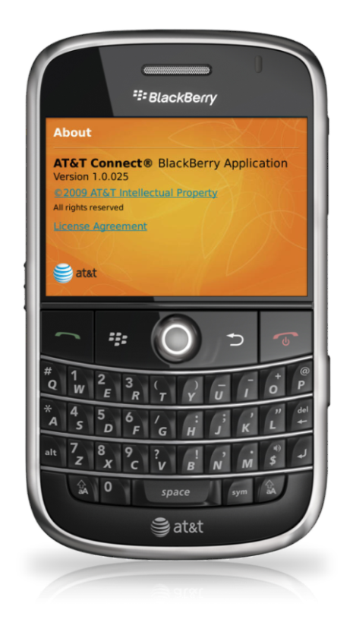
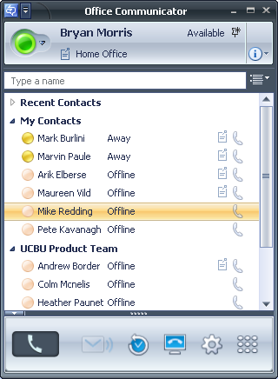
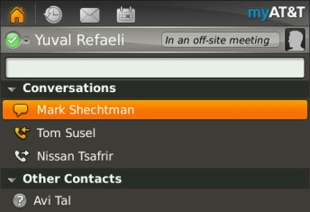
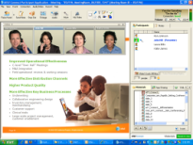
AT&T Offers You Many Paths to UCC
Unified Communications
AT&T Managed / Hosted UCC
AT&T Cloud-based UCaaS*
AT&T Custom, On-Premises UCC Solutions
Conferencing & Collaboration
IP Telephony
Mobility
Messaging
Audio, Video & Web Conferencing
AT&T Connect®
Managed, Hosted Cisco and Avaya IPT, UC
Premises Based IPT, UC
Contact Center
Fixed Mobile Convergence (FMC)
Mobile Business Applications
Presence Integration
Hosted Microsoft OCS®, Exchange® & SharePoint®
Unified Messaging
Multi-Vendor Technology Integration
AT&T Telepresence Solution
*Service roll out is subject to change, modification or delay.
Page 8

Slide 9
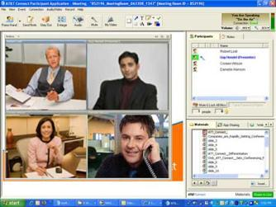
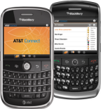
Leading Collaboration Capabilities Integrated with Your UC Solution
AT&T Connect® Converged Audio, Web, Video Conferencing
AT&T Telepresence Solution
Inter-company Telepresence Meetings Powered by AT&T Business Exchange Network
Rich Immersive Experience
Complete Concierge Services
Desktop, Mobile, Browser-based Clients
Presence, UC Features
Highly Scalable
Integrated with AT&T Global IP Audio Conferencing
Fully Hosted, Hybrid Deployment Capabilities
Integrates with UC Platforms, Email, other applications

Slide 10
Shell Chose AT&T
Delivering enterprise-wide hosted and managed unified communications services to 150,000 users in more than 90 countries worldwide based upon the Microsoft Office Communications Server®
Notes:
Shell is our largest non-US based commercial account.
It was originally a global network sourcing contract ...with AT&T assuming responsibility for Shell’s worldwide communication infrastructure and for transforming it to common technology platform, consistent operational discipline and common processes
It has grown and now expanded to become the largest unified communications deployment we’ve undertaken for a single customer.
What we’re doing with Shell will transform communications for their 150,000 employees, customers and vendors in more than 90 countries … giving them web and video conferencing down to the device level.
This deployment around the world is supported by our Internet Data Centers in the Netherlands, United States and Singapore.
We’re really proud of the work we’re doing with Shell. This is one example that shows the power of a new kind of convergence.
And we’ve just begun. There’s huge potential for other companies and other industries.
May 2010 -- Shell has awarded AT&T a three-year, $90 million agreement to provide an enterprise- wide unified communications service to support Shell’s 150,000 users in more than 90 countries. The AT&T solution is the largest UC technology deployment to date by AT&T for a single business customer. The service will provide Shell users with a suite of services to better enable inter-company and external collaboration, productivity and communications. AT&T is providing a comprehensive, worldwide hosted and managed UC solution based upon Microsoft's Office Communications Server 2007 R2.
The initial roll-out to users started earlier this month.
The initiative comes on the third anniversary of a global estimated $1.6bn multiyear strategic sourcing agreement signed in 2008 when Shell selected AT&T to manage a significant part of its IT infrastructure and telecommunications services. AT&T is already managing Shell’s global deployment of the previous version of Microsoft’s software. These new UC services are part of that agreement.
The UC solution covers a unified set of data, voice, and video capabilities and services to implement Shell’s Digital Workplace vision. It will enable Shell employees, contractors and partners to benefit from improved productivity and workplace efficiency via secure corporate instant messaging, enhanced “presence” information across various means of communication for information workers anywhere in the world, streamlined communications with Enterprise Voice calling features such as click to call, forward, transfer, single number reach, anywhere access to communications, and integration with the company’s desktop applications.

Slide 11
Notes:
11

